Slide 1

Welcome – SEHAUC National Conditions Re-Brief Nov 2018
No planned test – exits/muster point
Phones – silent/off
Facilities

Slide 2

Programme
1.30pm: Paul Dooley - Welcome – Introductions-Analysis
1.40pm: David Latham – HAUC England
1.50pm: Emma Dodd – Table Exercise Scenarios
2.30pm: Feedback and Discussion from Table Exercises
2.45pm: Summary
3pm: Finish (Drive Safely)
Notes:
Introduce Jeff Elliott
And all associated facilitators on the day

Slide 3
Operational Guidance for Permit Schemes & use of National Conditions Text (NCT)
It is highly recommended that permit applications include any conditions that the work promoter feels are appropriate for the works being undertaken (planned activities only).
Any additional authority imposed conditions applied must be reasonable and comply with Regulations. Any cost implications associated with the use of conditions should be proportionate and carefully considered.
Works promoters should ensure that site operatives are aware of the conditions attached to permits and the Traffic Management agreements that are in place.
Notes:
Who has seen this/read it? Parts of it, you will know but not sure how you know!
Salient points from pages 40-41 – why we are here today

Slide 4
Analysis of Permit Applications (PAs) & Permit Modifications/Refusals
NCT06a: to maintain 1.2m on the footway
NCT07a: apply for road closure (in both applications and PMRs)
NCT08a: included in applications (and in PMRs) to state same as in TM field
NCT08b: manual control 7am-7pm as road is traffic sensitive
NCT09a: Applied to Immediate Activities as AIVs
NCT11b: letter drop to shops/businesses in works vicinity; or for disconnection of feeder to advertising hoarding or Street Light
NCT13: specialist materials not to be left on site
Refusal or PMR containing “Essential NCTs omitted…”
Notes:
1000s of examples
Variances within authorities and within promoters – lack of consistency
We could add in NCT4b for spoil removal at 6pm; or NCT9c for TM decommissioned within 4 hrs on a c/w reinstatement
Post-it Notes

Slide 5
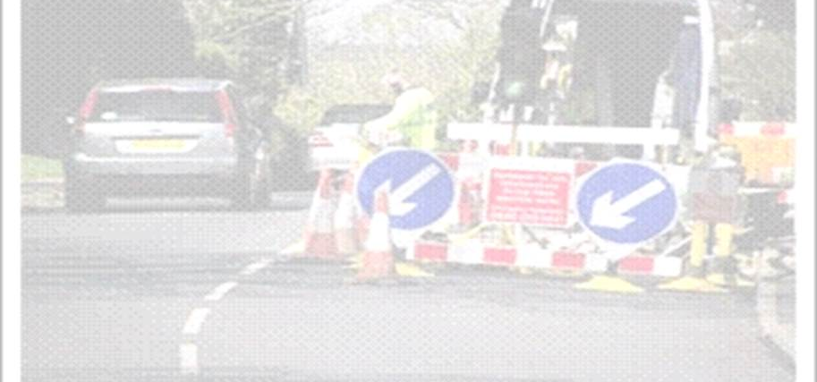

HAUC(England) Guidance
Operation of Permit Schemes
(inc. Permit Condition Text)
David Latham
Joint Chair HAUC (England)

Slide 6
Foreword
“I support the introduction of well-developed and reasonably operated permit schemes as the best means of proactively managing the road network, essential to support the country’s economy.
I am pleased to see how many authorities have seized the opportunity to introduce such a scheme, and would like to see more.
I applaud the
work undertaken by HAUC (England) to produce this practical day to day operational guidance to support schemes.”
Andrew Jones MP
Parliamentary Under Secretary of state for Transport
Notes:
This document has full support from Parliament and is fully supported by the DfT. Although it is still non-statutory, engagement and take up of the document could see it having statutory status in the near future.

Slide 7



The best outcomes from permit schemes can be achieved where Works Promoters and Permit Authorities work together to achieve the common objective of planning and implementing work effectively so that it has the least possible impact on highway users. Permits provide a powerful tool to help achieve this.
Peter Loft and David Latham
this document sets out the expectations of HAUC England and the Department for Transport for the operation of permit schemes.

Slide 8
Some wise words
Conditions play an important part within the permitting process and the guidance given within this document defines when and how conditions should be applied and how these should be communicated. It also offers to allay any misinterpretation of conditions by giving clear examples of when appropriate conditions should be used and when existing legislation is sufficient to enable works are deployed in a safe manner.
Part II: Guidance on the Use of National Condition Text
The purpose of this part of the HAUC England guidance document is to help you effectively and proportionately use permit conditions to mitigate the impact of street and road works on those affected by them in their daily lives.

Slide 9



Slide 10


Slide 11
Table Exercise
Be honest with each other
Be prepared to be challenged
Be willing to share
Be respectful
Notes:
Is it clear from promoter to authority what it is the authority need to see; is it clear from authority to promoter what it is that needs to be achieved.

Slide 12

NCT01 (a)(b)
Date Constraints
Applies to ALL permits
No reason to attach (auto apply)
Permit should not be refused for inclusion or exclusion of this condition
NCT01a/b
Notes:
NCT01a – Duration APPLIES TO ALL PERMITS on streets where the validity window does not apply
NCT01b – Duration APPLIES TO ALL PERMITS on streets where the validity window applies
NCT01a/NCT01b apply to all permits as appropriate. There is no reason to attach these conditions to a permit application as the appropriate condition will still apply if omitted. If they are attached, the correct condition;
NCT01a/NCT01b must be utilised depending on the appropriate validity window. In avoidance of doubt it is advised not to reference NCT01a or NCT01b. The Permit Application is not to be refused for either the inclusion or exclusion of this condition (unless it is incorrectly applied).

Slide 13
NCT02a
Time Constraints
Limits time of day
Clarifies the timing of occupation
In theory ‘Reduces the working hours’
Normal working Hours (Permits)
8am to 6pm Mon to Fri
8am to 1pm Sat
No works on a Sunday
Notes:
Working hours are defined under Section 61 of the Control of Pollution Act 1974.
This condition is to be used to limit timings of activities. It is to be used to clarify when the highway can be occupied. This is not to be confused with NCT05a which relates to limiting the extent of the works footprint.
➢ It should be noted that the working day is not the notice day.
➢ If no working hours have been added to the permit application then the agreed assumption is that works will take place within the window of 8am-6pm Monday to Friday and 8am-1pm Saturday.

Slide 14
NCT02b
Time Constraints
Extends the time of day
Clarifies the timing of occupation
In theory ‘increases the working hours’
Utilise OOH Box
N/A for Immediate works
Normal working Hours (Permits)
8am to 6pm Mon to Fri
8am to 1pm Sat
Notes:
If no working hours have been added to the permit application then the agreed assumption is that works will take place within the window of 8am-6pm Monday to Friday and 8am-1pm Saturday. If works take place outside of these times
the OOH tick box should be used and the hours of work should be made clear by use of this condition. The Works promoter should make reasonable endeavors to work within the agreed hours, if works take place unreasonably
outside these hours without prior agreement the Permit Authority may take reasonable actions.
This isn’t intended for use on Immediate works.

Slide 15


NCT03
Out of Hours work
This condition should NOT be used
Notes:
NCT03 – This NCT should not be used. It cannot be attached to any permit as currently there is no condition attached to this code. By checking the OOH box does not impose the use of NCT03

Slide 16
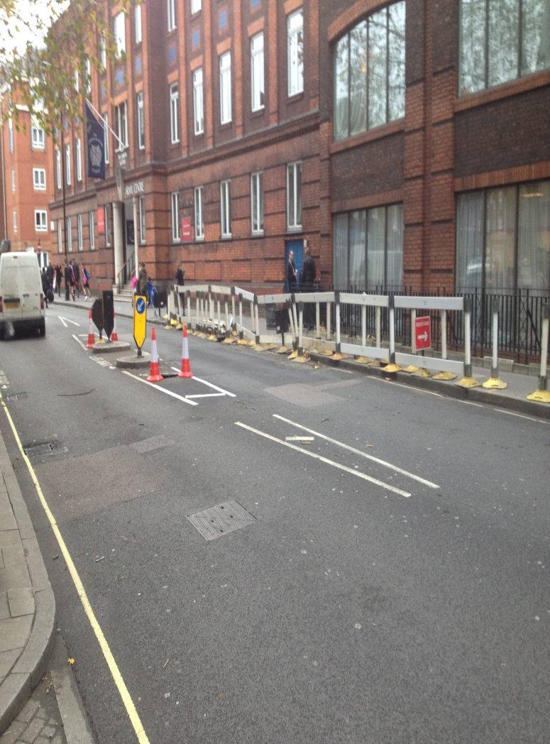
NCT04a
Material & Plant Storage
This condition should be imposed to
  Limit the footprint
  Remove excess plant & materials
  PA should give reason for use
Not to be imposed on every permit
Timescales - realistic
Notes:
NCT04a - Practical use of this condition would be in areas where there is a night time economy or where there is a need to limit the activity footprint due to heavy traffic etc. It is site specific and when requested the reasons for its inclusion are to be given. This condition would be at the request of the Authority.
Not to be imposed as standard on every permit.

Slide 17

NCT04b
Storage of Surplus Material and/or plant
This condition should be imposed to
  Limit the storage of plant & materials within the site
  May require storage ‘off site’
  PA should give reason for use
Not to be imposed on every permit
Timescales - realistic
Notes:
NCT04b - This condition will be used when it is necessary to limit the length of time or the area required to store plant and materials on site prior to their use and a valid reason for the application of this condition will be given, e.g. so as not to cause congestion during the works or during a special event. This condition should only be applied on a works by works basis and not applied to all permits. This condition would usually be requested by the Permit Authority.

Slide 18
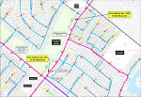
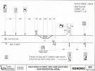
NCT05a
Road Occupation Dimensions
This condition could be used to
Define the area in which the works can be undertaken
Should be detailed within a Traffic Management plan
Notes:
In accordance with paragraph 4 in the introduction to this part of the guidance set out above, the relevant EToN TM type need not also be attached as a condition. For example; if a promoter has used the EToN TM type of “No carriageway incursion” then there is not also a need to attach this condition. The Permit Authority may however take reasonable actions if the TM type differs to that stated on the permit.

Slide 19

NCT06a
Traffic Space Dimensions
Define the minimum width of a footway or carriageway to be maintained
Should not conflict with the Safety Codes of Practice
Not applied where Safety Codes is deemed the minimum
Reasons over and above the Safety Codes should be given
Notes:
NCT06a – NCT06a is only to be used where it is required to maintain an existing provision in excess of the widths stated in the code of practice for safety at street works and road works e.g.1.5m in the footway and 3.75m in the c/w. Practical examples would be areas of high pedestrian footfall i.e. outside stations/shopping centres, sport facilities etc. NCT06a is not be used as an indication that a pedestrian walkway will be provided. This condition is not to be used to increase residual carriageway widths as it may conflict with the Statutory Safety CoP.

Slide 20

NCT07a
Road Closed to Traffic
Not applied to all Road closures
Not to mandate a ‘gateman’
At request of Permit Authority
  Closure of Minor Road at a junction
  Is NOT an addition to the TTRO process
Notes:
NCT07a – This condition is not to be applied to all permits requiring a road closure but there may be occasions where an authority may require this condition i.e. closure of a minor road on a signalised junction to alleviate congestion on the primary route. NCT07a is site specific where circumstances dictate and is not an addition to the TTRO process in normal circumstances

Slide 21

NCT08a
Traffic Management Request
Where TM over and above the Safety Codes is required
To be used where TM has NOT been stated by promoter
That TM is required at specific times
  Stop/Go near a school between 1500 & 1600
NOT applied on every occasion TM is used
Notes:
NCT08a – This condition is to be used where a particular method of traffic control is required, this may be Stop/Go boards to control a parking facility. This could be a lesser or greater requirement than that stated. This may also be required at certain times during the execution of the works. NCT08a would be requested where the promoter has not identified the traffic management or the method identified is considered inappropriate

Slide 22

NCT08b
Manual Control of Traffic Management
Authority driven
Site Specific
Time Specific
Not applied to all permits with TM
Defined reason to be given
  Substantial Financial Impact
  Technology – remote operation
Notes:
NCT08b – This condition is to be applied as per the instruction of the Authority, it is site specific and not applied to all permits that require the use of signals. It is recommended that supplementary text be added in the short text to indicate the outcome required. Examples include traffic is not to build up past Junction A, proactively managing traffic flows through the site based on tidal requirements etc
There is a substantial financial impact associated with this condition so careful consideration should be taken prior to requesting. Promoters and Authorities should be aware that this may be undertaken remotely.

Slide 23
NCT09a
Traffic Management Changes
Promoter driven
Telephone Call & Variation
Not used on ALL works
By exception
Convoy System
to
Protect Workforce
Notes:
NCT09a – The use of this condition is to inform the authority prior to any agreed changes being made on site. Agreements may be made prior to works commencing or whilst works are in progress. Notification would be by means of a telephone call, and should be followed by a variation to the permit. This condition is to be used by exception.

Slide 24
NCT09b
Traffic Management Arrangements
Authority driven
Drives TM to be moved/completed prior to further phasing of works
Details to be supplied on a TM plan
Notes:
NCT09b- part 2 of these works cannot start until the Eastbound lane is open to traffic, as agreed in TM
plan 12345

Slide 25
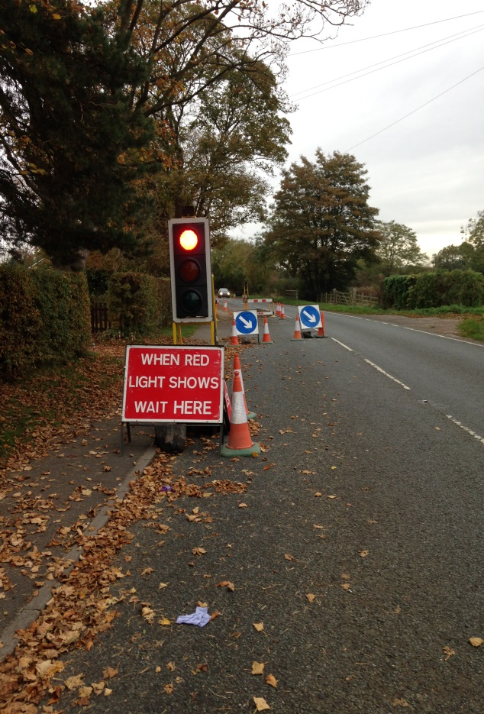
NCT09c
Signal Removal from operation when no longer required
Authority driven
Requires removal from the traffic flow of Portable traffic signals
Within 4 hours of work completion
Should not cause obstruction
Notes:
Signal heads do not need to be removed from site, only decommissioned and turned away from oncoming traffic. They should not be causing an obstruction for this condition to be complied with.

Slide 26
NCT10a
Employment of appropriate methodology
Methodology agreed in advance
Condition used by exception
Specific to particular works
May be more than one
NOT to be used for
  1st time reinstatement on all works
  Half/full width reinstatement
Notes:
The methodology to be used must be agreed in advance with the works promoter as this may not be
practical or suitable for the works that need to be undertaken. This condition should be used by exception,
where the methodology to be used is important to the site conditions. The methodology should be
specific to the circumstances of a particular works, for instance, it cannot be used as a standard condition
to insist on first time reinstatements on all permit applications [see paragraph 6 of this guidance
document].
If, once on site, it is clear that the agreed methodology cannot be used then the promoter must contact the authority straight away during working hours or first thing the next working day to discuss an alternative agreed methodology.
It should also be noted that more than one methodology may be listed.

Slide 27
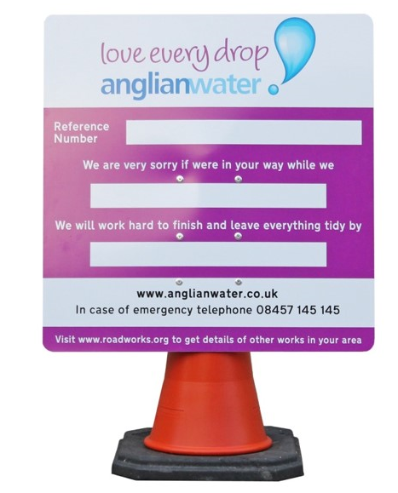
NCT11a
Display of Permit Number
Applies to all Permits
Prominent Place
Not mandatory to attach condition as it applies to all permits
May require more than 1 board on large sites
Notes:
NCT11a – As NCT11a applies to all permits there is no reason to attach this to the permit application as it will still apply if omitted. If however attached there is no need to request removal. As with NCT01a and NCT01b the permit application is not to be refused for the inclusion or omission of this condition

Slide 28

NCT11b
Publicity for proposed Works
Advanced Information Boards
Variable Message Boards
Exceptional Locations
Exceptional circumstances (Night work)
Notes:
Accepted methods of publicity could include advanced information signs, use of Variable Messaging Signs (VMS), social media and letter drops etc. as appropriate. The application must be reasonable and include the method and timescales required appropriate to the impact to the network. Due to the nature of advanced information this condition cannot be applied to immediate permits, and would only apply to minor works where minimum notice periods are not used

Slide 29
NCT12a
Limiting time of Activities
Used for environmental issues
  Noise
  Light etc.
Clear reason for application
Notes:
This condition should only be attached to permits where it is necessary to limit the time of day during which
certain activities can take place. As an example, the works may be permitted to take place until 10pm
however the element that involves slot cutting can only take place before 6pm.
The reason for the restriction should be made clear e.g. residential area/directions from Authority

Slide 30
NCT13
Condition(s) not covered
Not routinely used
Where site requirements dictate
It is NOT a local condition
Exceptional circumstances (e.g NATO Conference)
MUST be agreed with works promoter prior to application
Notes:
NCT13 is not to be routinely utilised. It is only to be used where the site specific requirements dictate. It is not a local condition that would apply over and above NCT01a - NCT12a, or a mechanism to apply previous conditions that are not covered in the Statutory Guidance.
➢ This category can only be used in unique exceptional circumstances. It MUST only be used with approval and be discussed and agreed with the works promoter before application

Slide 31
Authority Imposed Variations (AIVs)
8.4 Authority Imposed Variation (AIV)
If a Permit Authority needs to make a change to a granted permit it can do so by sending the promoter an Authority Imposed Variation (AIV).
An AIV should only be sent where it is not possible to send another permit response e.g. Grant or PMR and should only be sent due to unforeseen circumstances once a permit has been granted.
The reason for the AIV should be made clear. It is good practice and highly recommended that an AIV is preceded by a conversation with the works promoter about the reason for the AIV.

Slide 32
Revoke Permit
8.5 Revocation of permits
Permits should only be revoked by the permit authority in exceptional or unforeseen circumstances, repeated breach of conditions or safety issues
In such circumstances, the Authority should inform the works promoter as soon as possible and explain the reason for the revocation

Slide 33
Carriageway Incursion
No carriageway incursion – This should be utilised when all of the works are undertaken outside the parameters of the carriageway (i.e. wholly within the footway, footpath or verge etc.)
Some carriageway incursion – This should be utilised when some part of the works has an impact on traffic in the carriageway, including the parking of works vehicles where there are restrictions imposed (yellow lines etc.), excavations or signing, lighting and guarding and the incursion does not warrant the use of any of the more severe traffic management methods
In all of the above situations, the deployment of a mandatory directional arrow sign (diag. 610 TSRDG 16) will be required. Deployment of this sign should be the trigger for identifying some carriageway incursion.
HAUC UK Carriageway Incursion

Slide 34
If You Take Anything Away…
You are enablers
Less is More
Important Information
Use the Guidance
Communicate
Trust
Notes:
Works are essential, no-one is there whose role is to stop works happening – we must all deliver with thoughts as to how to best mitigate any disruption the works may cause
Don’t load the permit with NCTs – it is easy to lose sight of what is important on the ground
Speak to each other – no more than 2 interactions via the Permit before Granting
Build trust in each other – go and sit with each other if possible
Is it clear from promoter to authority what it is the authority need to see; is it clear from authority to promoter what it is that needs to be achieved
You do not need to show your working!

